Slide 1


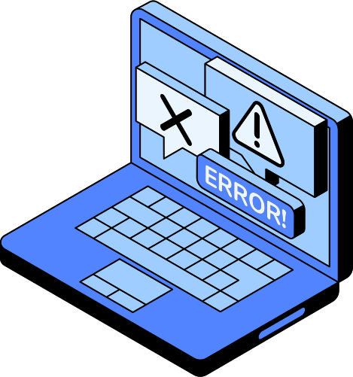
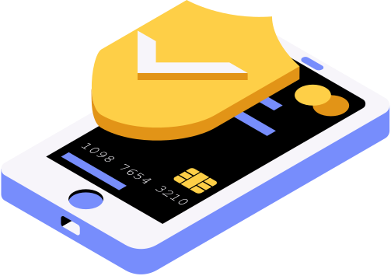
CYBER
SECURITY

Slide 2
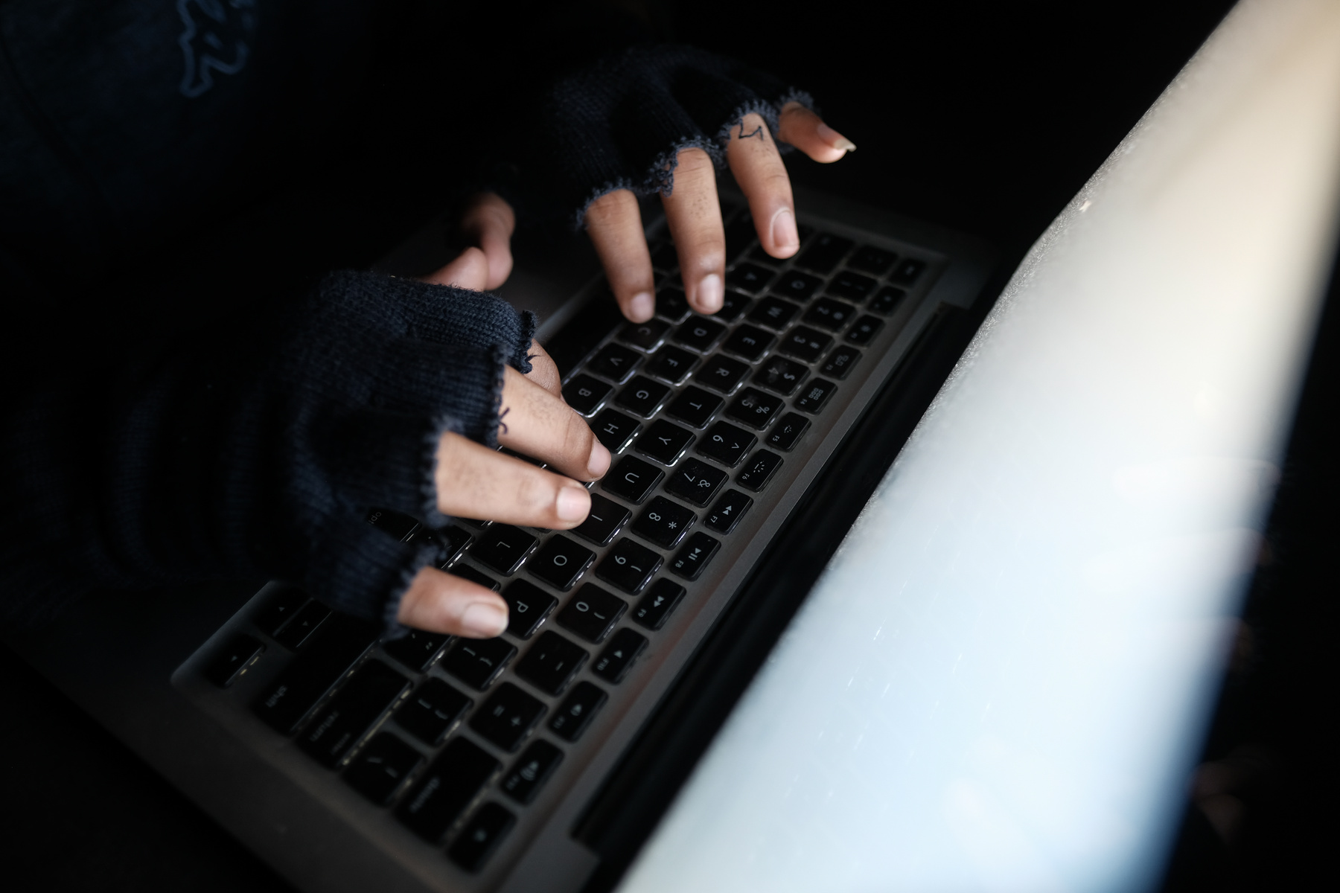
INTRODUTION TO PHISTING
Definition – Phishing is a cyber-attack that tricks people into revealing sensitive information.
Method – Attackers use fake emails, messages, or websites to steal data.
Types – Includes email phishing, spear phishing, vishing (voice), and smishing (SMS).
Signs – Suspicious links, urgent messages, unknown senders, and poor grammar.
Prevention – Avoid unknown links, verify sources, use MFA, and stay informed.

Slide 3




WHAT IS PHISHING
03/15
Phishing is a cyber-attack that tricks people into revealing sensitive information.
Attackers use fake emails, messages, or websites to steal data.
Common targets include passwords, bank details, and personal information.
Warning signs include suspicious links, urgent requests, and unknown senders.
To stay safe, avoid clicking unknown links, verify sources, and use MFA.

Slide 4

Email Phishing – Attackers send fake emails pretending to be from legitimate sources to steal login credentials or personal data.
TYPES OF
Spear Phishing – A targeted attack aimed at specific individuals or organizations using personalized messages to trick victims.
PHISHING ATTACKS
Vishing (Voice Phishing) – Scammers use phone calls to impersonate trusted entities (like banks or tech support) and steal sensitive information.

Slide 5
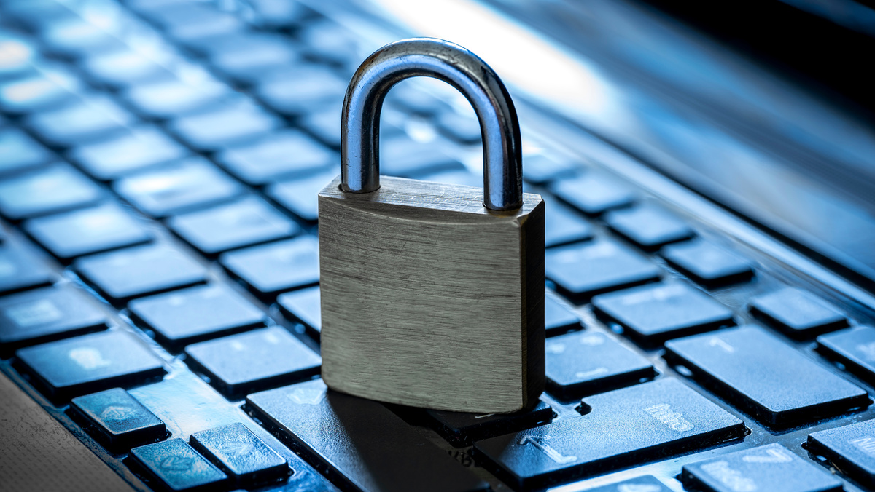

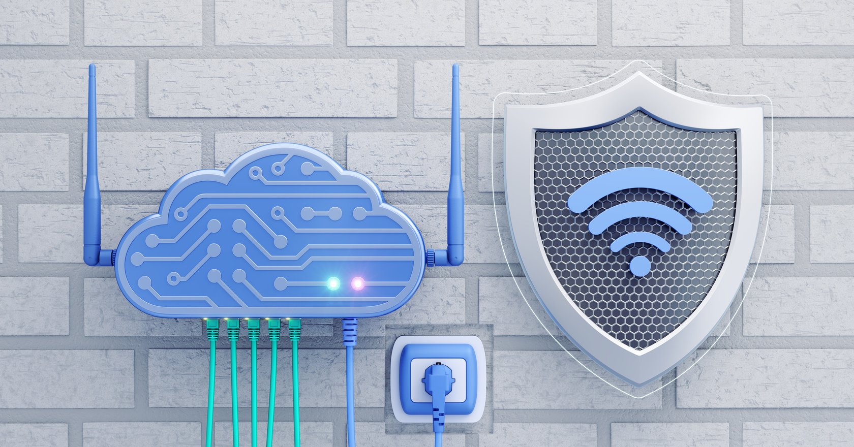
Suspicious Links
SIGNS OF
URLs that look legitimate but redirect to fake websites.
A PHISHING ATTEMPT
Urgent Requests
Messages creating panic to make you act quickly
Unknown Senders
Emails or messages from unfamiliar or odd-looking addresses.

Slide 6
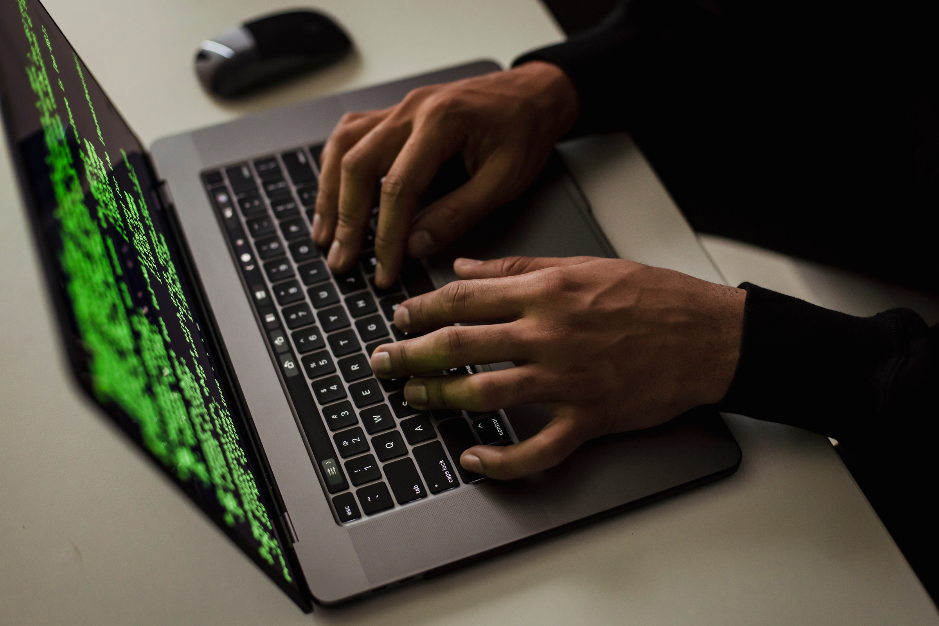
HOW
TO PROTECT YOURSELF
To safeguard against phishing, always verify the source of emails before clicking on links or downloading attachments. Use Mulltifactor authentication and keep your software updated. Educating yourself and others about phishing can significantly reduce risks

Slide 7

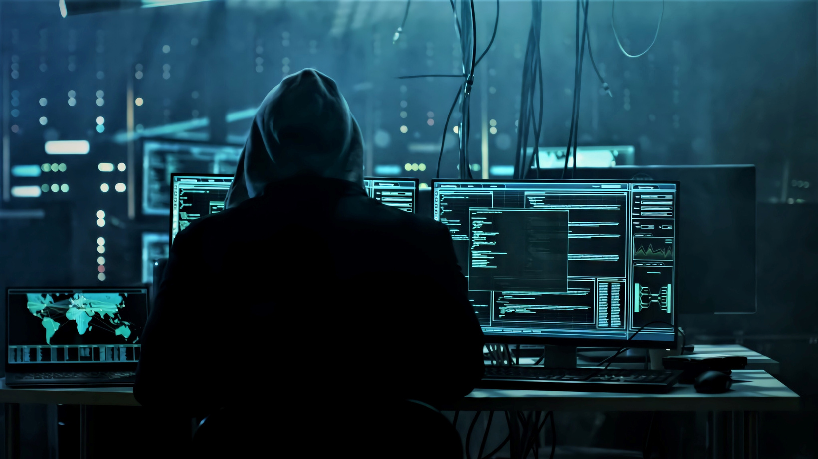
REPORTING
RepReport to Your Email Provider
PHISHING ATTEMPS
Most email services (like Gmail, Outlook, and Yahoo) have a "Report Phishing" or "Mark as Spam" option. When you report a phishing email, the provider analyzes it and blocks similar emails from reaching other users. This helps improve email security and prevents scammers from targeting more people.
Report to Cybersecurity Authorities
Government and cybersecurity organizations, such as the FTC (USA), CERT-In (India), Action Fraud (UK), or Anti-Phishing Working Group (APWG), collect phishing reports to investigate and take action against scammers. Reporting to these agencies helps shut down fraudulent websites and alert the public about ongoing threats.

Slide 8

PHISHING IN THE FUTHURE
Phishing in the future will become more advanced and harder to detect with AI-powered attacks, deepfake scams, and smarter social engineering. Mobile phishing (smishing) and cloud-based attacks will rise, making cybersecurity awareness and strong security measures like AI-driven threat detection and multi-factor authentication (MFA) essential for protection.

Slide 9

THANK
YOU!
usedrehman123@gmail.com
usaid ur Rehman
www.linkedin.com/in/usaid-ur-rehman-30ab771b7

